Slide 1

10. CSS 애니메이션
WEB 개발 기초 과정
HTML / CSS / JavaScript / Python

Slide 2
1
CSS 애니메이션

Slide 3
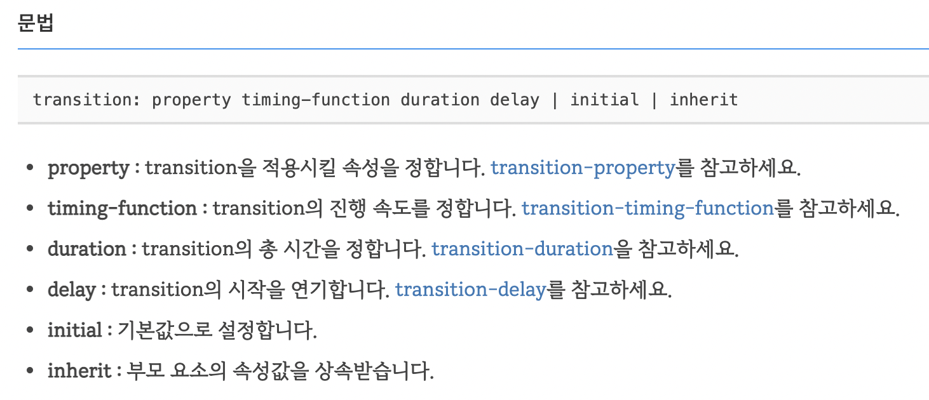
01
Transition
속성을 서서히 변화시키는 속성

Slide 4
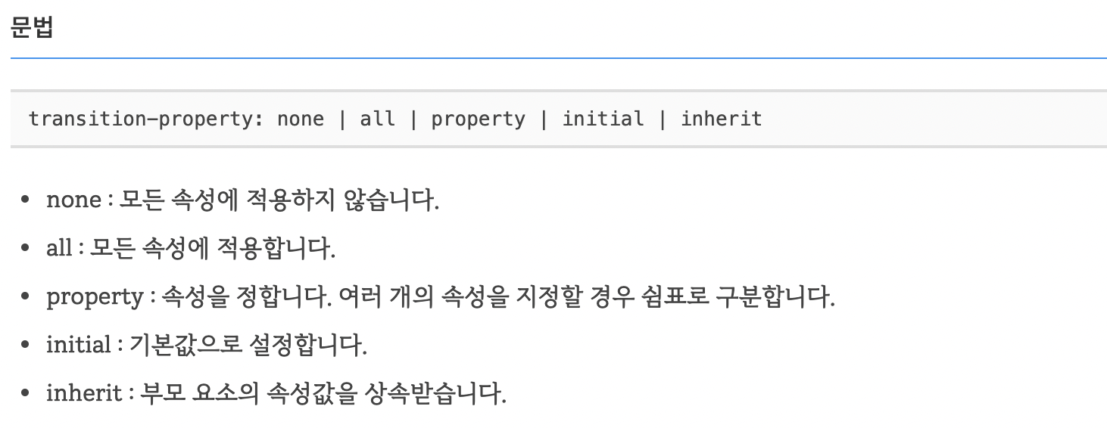
01
Transition
transition-property로 transition이 적용될 속성을 정합니다

Slide 5
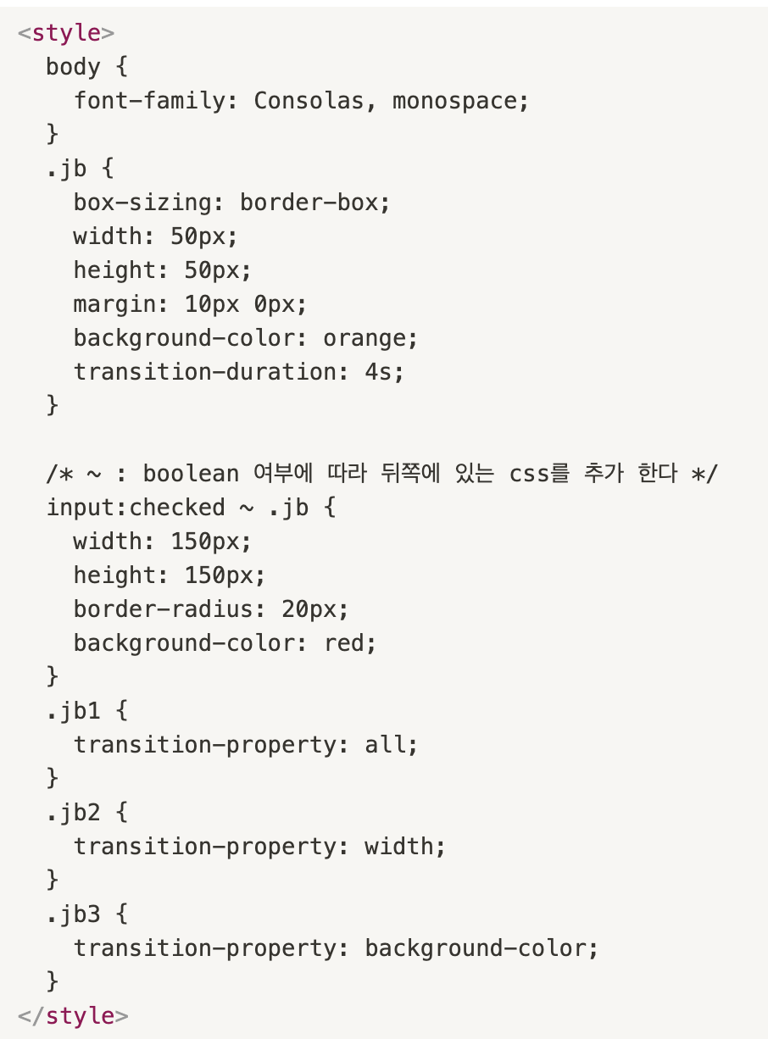
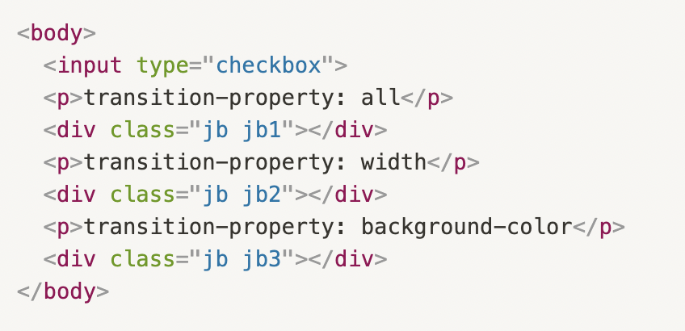
01
Transition
transition-property로 transition이 적용될 속성을 정합니다
Notes:
<!doctype html>
<html lang="ko">
<head>
<meta charset="utf-8">
<title>CSS</title>
<style>
body {
font-family: Consolas, monospace;
}
.jb {
box-sizing: border-box;
width: 50px;
height: 50px;
margin: 10px 0px;
background-color: orange;
transition-duration: 4s;
}
/* ~ : boolean 여부에 따라 뒤쪽에 있는 css를 추가 한다 */
input:checked ~ .jb {
width: 150px;
height: 150px;
border-radius: 20px;
background-color: red;
}
.jb1 {
transition-property: all;
}
.jb2 {
transition-property: width;
}
.jb3 {
transition-property: background-color;
}
</style>
</head>
<body>
<input type="checkbox">
<p>transition-property: all</p>
<div class="jb jb1"></div>
<p>transition-property: width</p>
<div class="jb jb2"></div>
<p>transition-property: background-color</p>
<div class="jb jb3"></div>
</body>
</html>

Slide 6
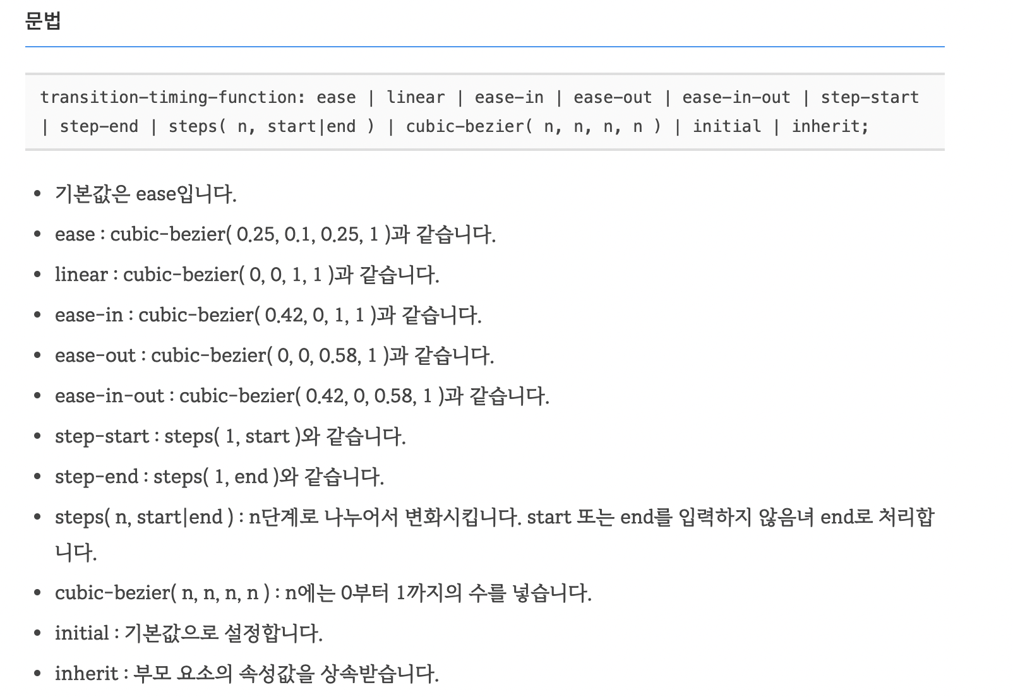
01
Transition
transition-timing-function으로 transition의 진행 속도를 조절할 수 있습니다

Slide 7
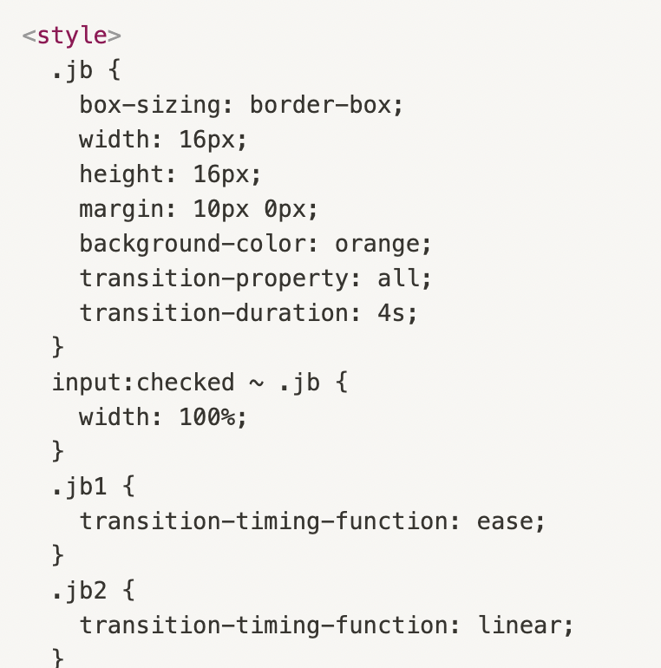
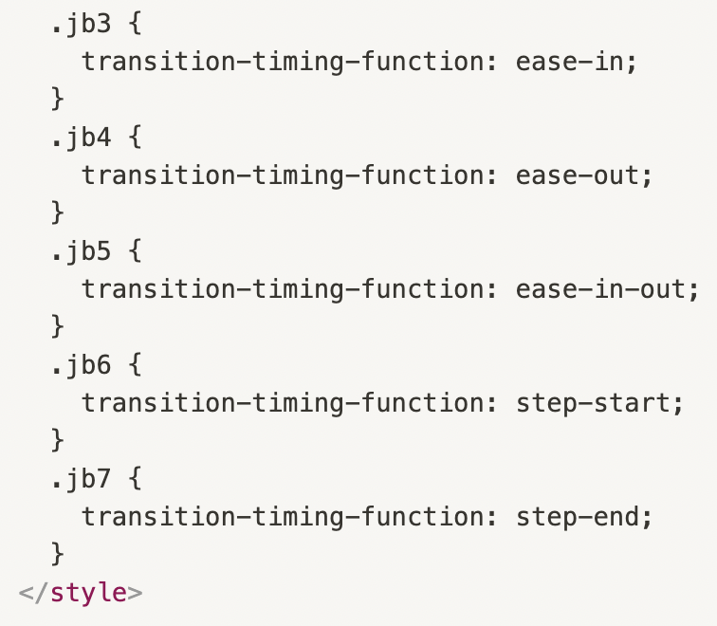
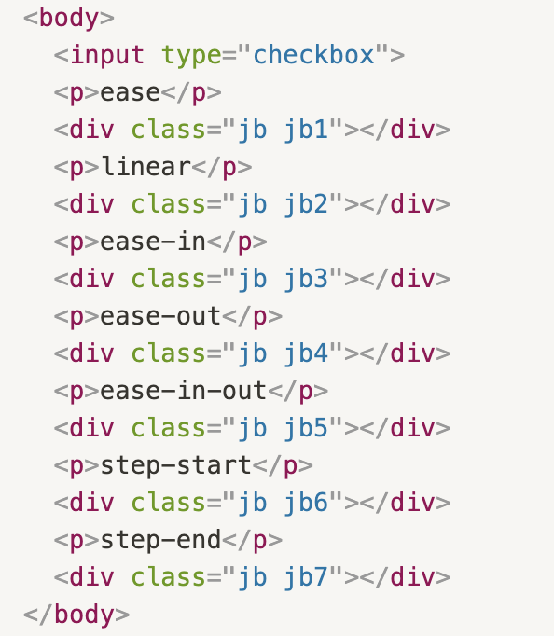
01
Transition
transition-timing-function으로 transition의 진행 속도를 조절할 수 있습니다
Notes:
<!doctype html>
<html lang="ko">
<head>
<meta charset="utf-8">
<title>CSS</title>
<style>
.jb {
box-sizing: border-box;
width: 16px;
height: 16px;
margin: 10px 0px;
background-color: orange;
transition-property: all;
transition-duration: 4s;
}
input:checked ~ .jb {
width: 100%;
}
.jb1 {
transition-timing-function: ease;
}
.jb2 {
transition-timing-function: linear;
}
.jb3 {
transition-timing-function: ease-in;
}
.jb4 {
transition-timing-function: ease-out;
}
.jb5 {
transition-timing-function: ease-in-out;
}
.jb6 {
transition-timing-function: step-start;
}
.jb7 {
transition-timing-function: step-end;
}
</style>
</head>
<body>
<input type="checkbox">
<p>ease</p>
<div class="jb jb1"></div>
<p>linear</p>
<div class="jb jb2"></div>
<p>ease-in</p>
<div class="jb jb3"></div>
<p>ease-out</p>
<div class="jb jb4"></div>
<p>ease-in-out</p>
<div class="jb jb5"></div>
<p>step-start</p>
<div class="jb jb6"></div>
<p>step-end</p>
<div class="jb jb7"></div>
</body>
</html>

Slide 8
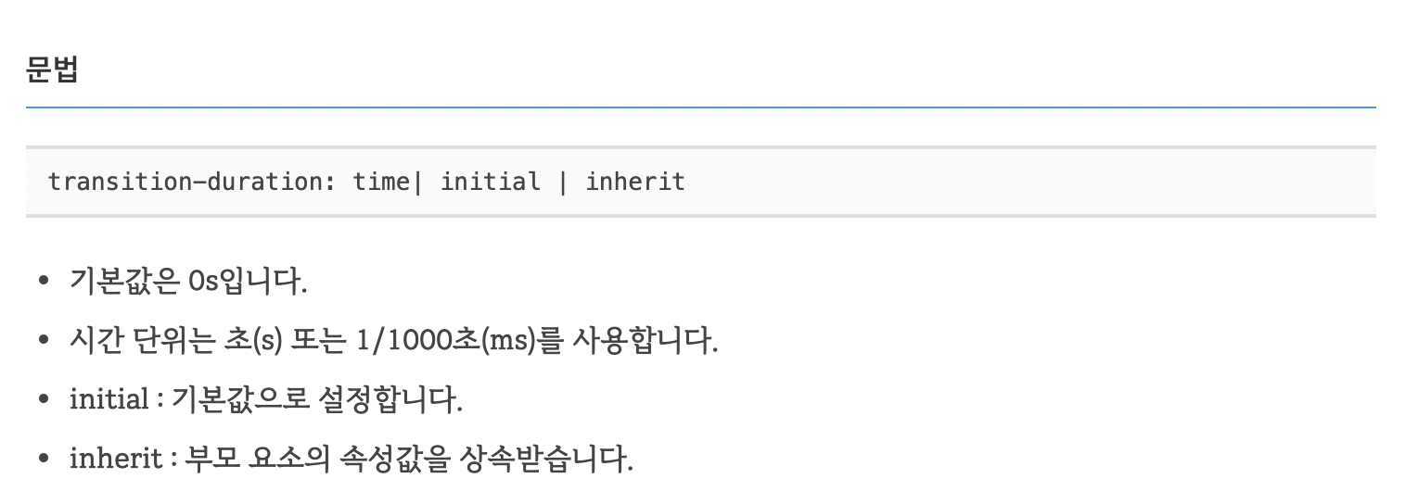
01
Transition
transition-duration로 transition이 끝날 때까지 걸리는 시간을 정합니다.
Notes:
<!doctype html>
<html lang="ko">
<head>
<meta charset="utf-8">
<title>CSS</title>
<style>
.jb {
box-sizing: border-box;
width: 16px;
height: 16px;
margin: 10px 0px;
background-color: orange;
transition-property: all;
transition-duration: 4s;
}
input:checked ~ .jb {
width: 100%;
}
.jb1 {
transition-timing-function: ease;
}
.jb2 {
transition-timing-function: linear;
}
.jb3 {
transition-timing-function: ease-in;
}
.jb4 {
transition-timing-function: ease-out;
}
.jb5 {
transition-timing-function: ease-in-out;
}
.jb6 {
transition-timing-function: step-start;
}
.jb7 {
transition-timing-function: step-end;
}
</style>
</head>
<body>
<input type="checkbox">
<p>ease</p>
<div class="jb jb1"></div>
<p>linear</p>
<div class="jb jb2"></div>
<p>ease-in</p>
<div class="jb jb3"></div>
<p>ease-out</p>
<div class="jb jb4"></div>
<p>ease-in-out</p>
<div class="jb jb5"></div>
<p>step-start</p>
<div class="jb jb6"></div>
<p>step-end</p>
<div class="jb jb7"></div>
</body>
</html>

Slide 9
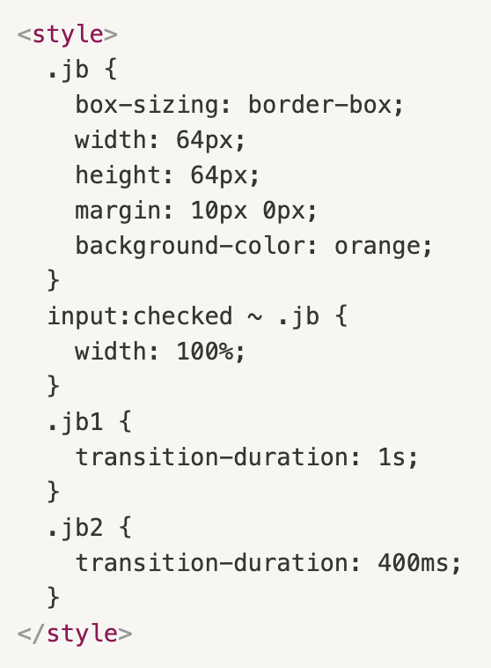
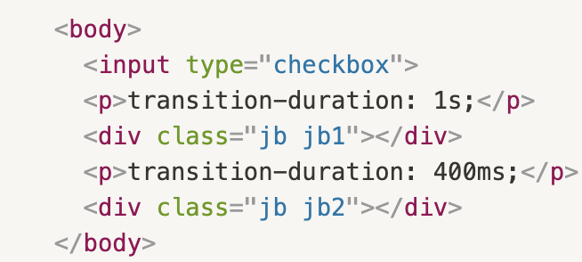
01
Transition
transition-duration로 transition이 끝날 때까지 걸리는 시간을 정합니다.
Notes:
<!doctype html>
<html lang="ko">
<head>
<meta charset="utf-8">
<title>CSS</title>
<style>
.jb {
box-sizing: border-box;
width: 64px;
height: 64px;
margin: 10px 0px;
background-color: orange;
}
input:checked ~ .jb {
width: 100%;
}
.jb1 {
transition-duration: 1s;
}
.jb2 {
transition-duration: 400ms;
}
</style>
</head>
<body>
<input type="checkbox">
<p>transition-duration: 1s;</p>
<div class="jb jb1"></div>
<p>transition-duration: 400ms;</p>
<div class="jb jb2"></div>
</body>
</html>

Slide 10
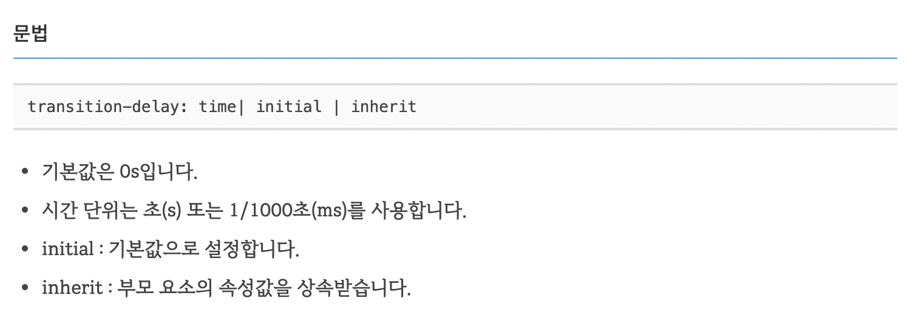
01
Transition
transition-delay로 transition이 시작하는 시간을 연기할 수 있습니다

Slide 11
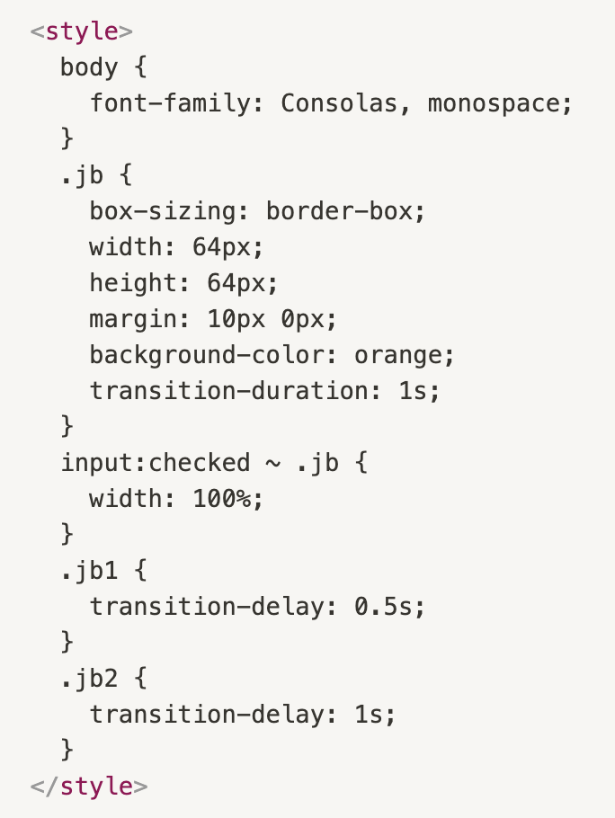
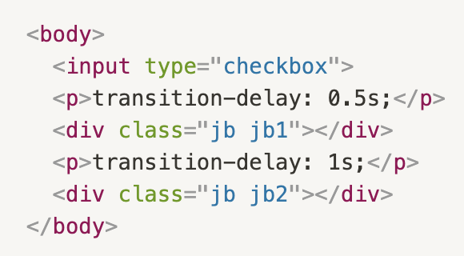
01
Transition
transition-delay로 transition이 시작하는 시간을 연기할 수 있습니다
Notes:
<!doctype html>
<html lang="ko">
<head>
<meta charset="utf-8">
<title>CSS</title>
<style>
body {
font-family: Consolas, monospace;
}
.jb {
box-sizing: border-box;
width: 64px;
height: 64px;
margin: 10px 0px;
background-color: orange;
transition-duration: 1s;
}
input:checked ~ .jb {
width: 100%;
}
.jb1 {
transition-delay: 0.5s;
}
.jb2 {
transition-delay: 1s;
}
</style>
</head>
<body>
<input type="checkbox">
<p>transition-delay: 0.5s;</p>
<div class="jb jb1"></div>
<p>transition-delay: 1s;</p>
<div class="jb jb2"></div>
</body>
</html>

Slide 12
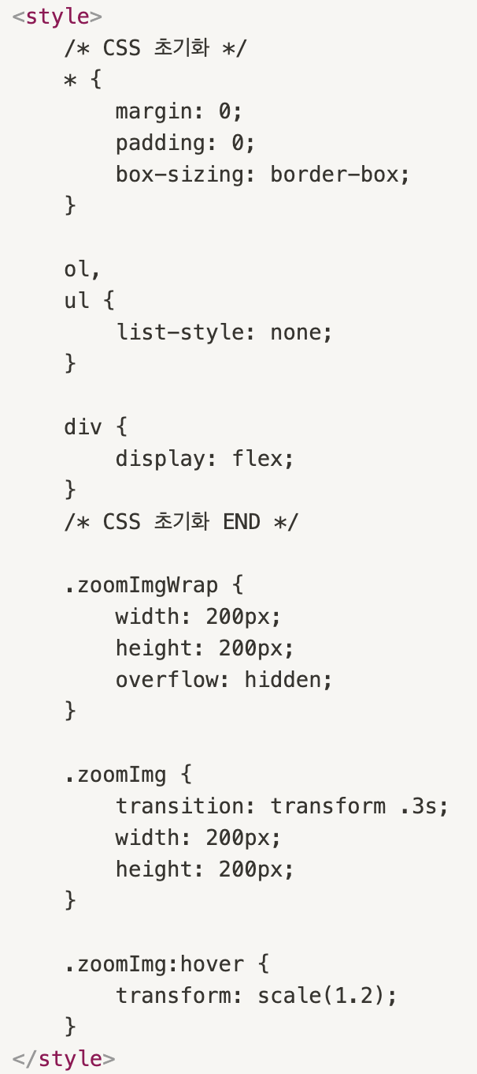
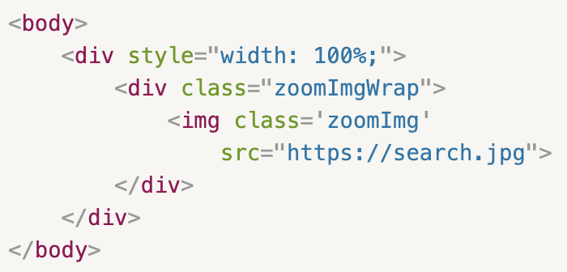
01
Transition
활용
Notes:
<!DOCTYPE html>
<html>
<head>
<meta charset="utf-8">
<meta name="viewport" content="width=device-width, inital-scale=1.0">
<style>
/* CSS 초기화 */
* {
margin: 0;
padding: 0;
box-sizing: border-box;
}
ol,
ul {
list-style: none;
}
div {
display: flex;
}
/* CSS 초기화 END */
.zoomImgWrap {
width: 200px;
height: 200px;
overflow: hidden;
}
.zoomImg {
transition: transform .3s;
width: 200px;
height: 200px;
}
.zoomImg:hover {
transform: scale(1.2);
}
</style>
</head>
<body>
<div style="width: 100%;">
<div class="zoomImgWrap">
<img class='zoomImg'
src="https://search.pstatic.net/common/?src=http%3A%2F%2Fblogfiles.naver.net%2FMjAyMTAxMTVfMjc5%2FMDAxNjEwNjk1NjgyNzIz.1BhFBukW0ZHGcxIaF1RCD57b2sjAYuUsupS9VgwFOGwg.5zQoTYrKx8nvAjXPefidVy4H1FliORIDpbp7PfqMm5Ig.JPEG.9736945%2F20210113%25A3%25DF211259.jpg">
</div>
</div>
</body>
</html>

